Slide 1
CHW Summer Café Chat #3
What’s Next for CHWs?
Motivating Patients and Communities to Choose Health
August 23, 2022 12:00 pm – 1:00 pm CT

Slide 2
Housekeeping
We will be recording this café chat, and the link will be posted on the NRC-RIM website:
https://nrcrim.org/toolkits/community-health-workers
Join the discussion on CHW Solutions’ facebook page: https://www.facebook.com/CHWSolutions2022/
Where are you joining from?
What is your role related to CHWs?
What are your CHW priorities for the next year?

Slide 3
Today’s Agenda
Introduction (Megan Ellingson, CHW Solutions)
Guided Meditation (Dra. Dulce Lopez, Consultant)
CHWs and Health Coaching Resources (Renee Gust, RN, Hennepin County Public Health)
CHWs Working with Primary Care Providers (Ron Jankowski, MD, CHW Solutions)
What’s Next for the Migrant Clinicians Network
(Alma Galvan, Migrant Clinicians Network)
Community Health Worker (CHW) Discussion
Paula Brown
Hilda Sanchez Herrera
Andre Pappas
Carol Parnell
Ashley Rodriguez
Fabiola Rodriguez
Ebonee Stevenson
Tarri Wyre
Closing (Megan Ellingson, CHW Solutions)

Slide 4
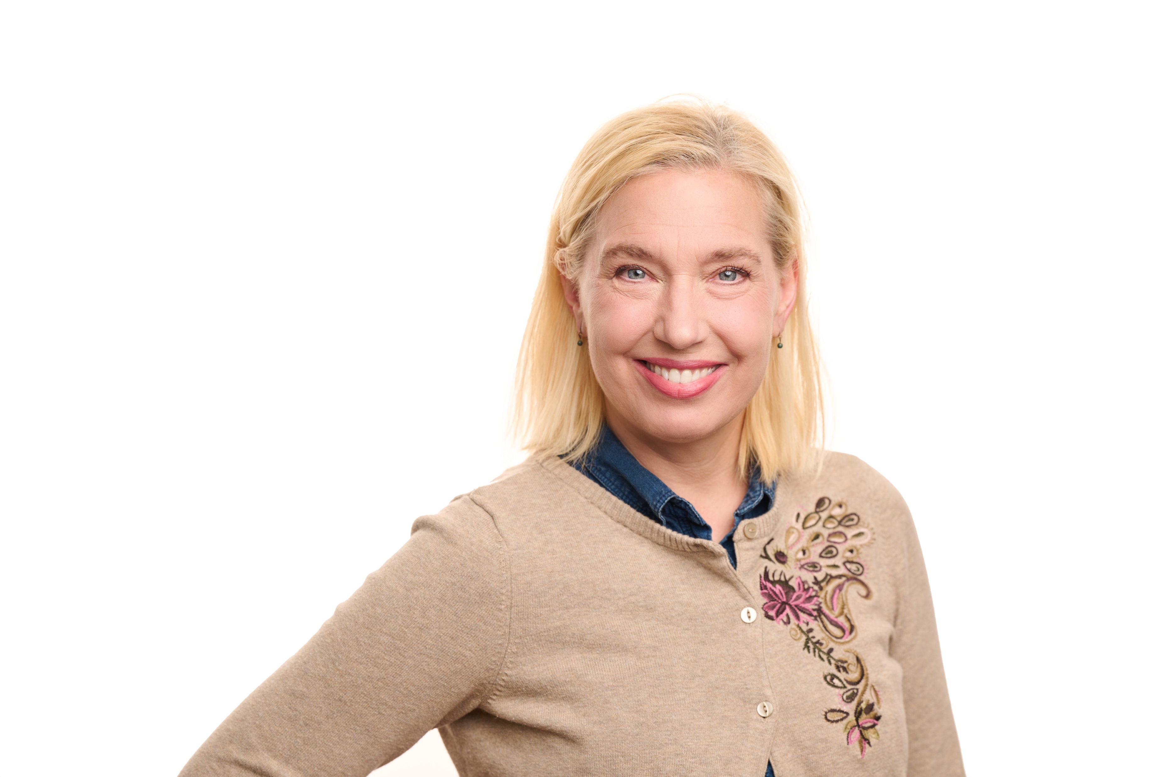
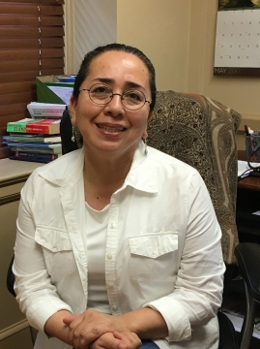
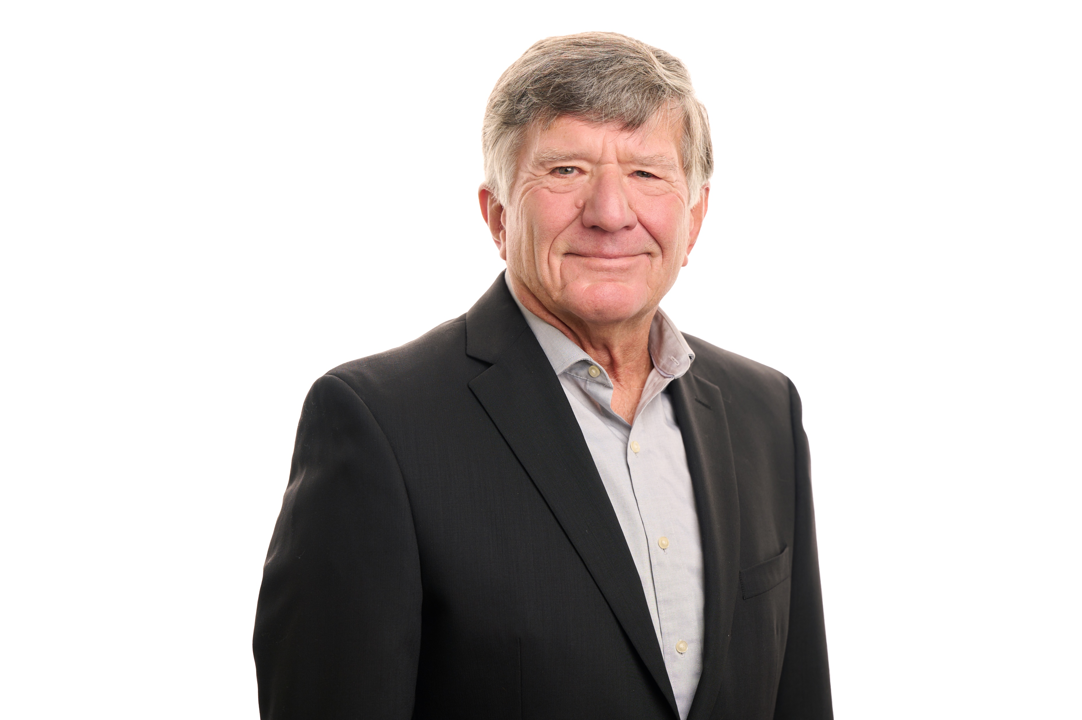
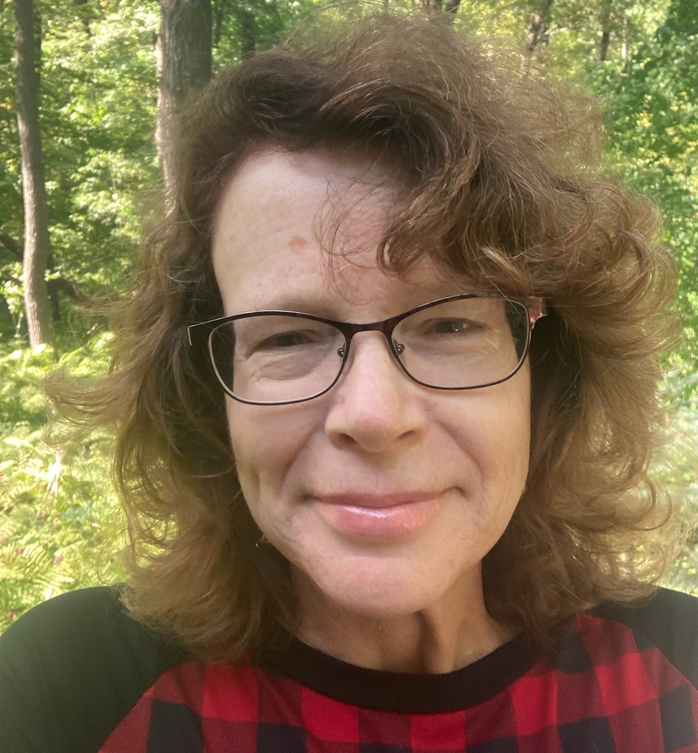
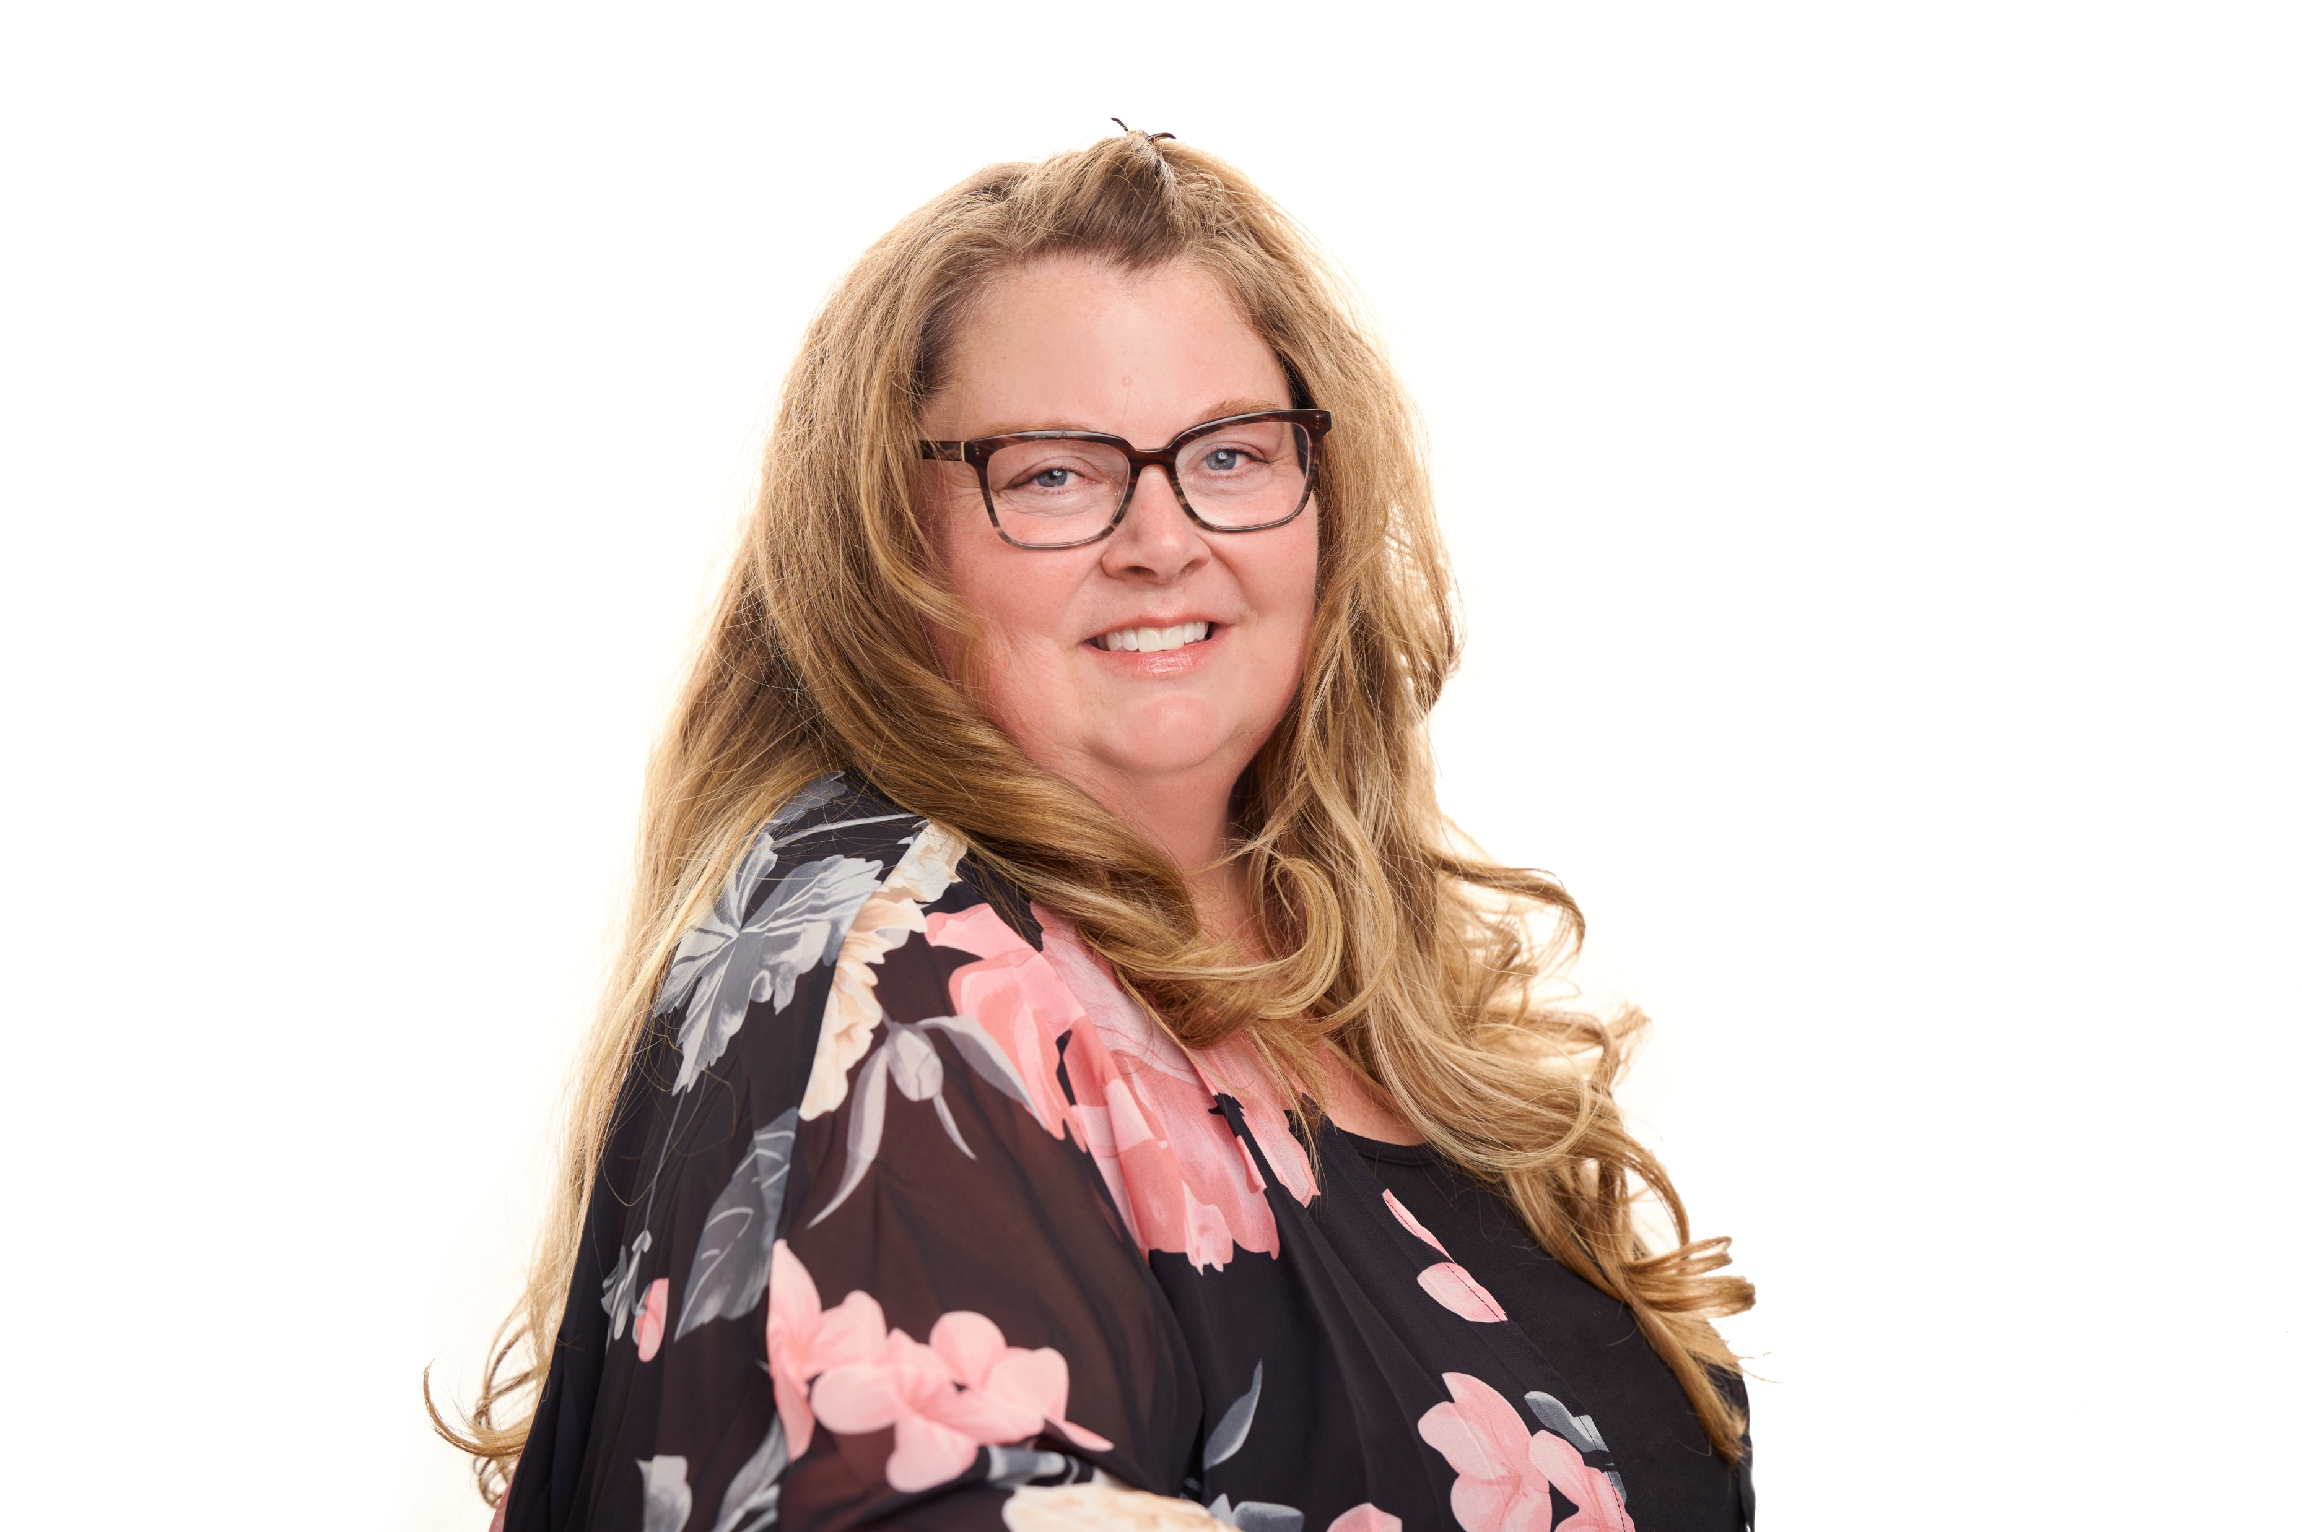
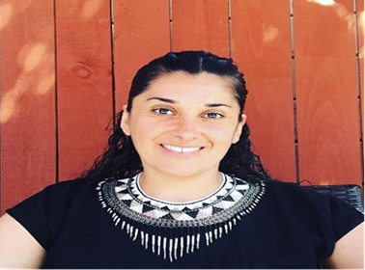
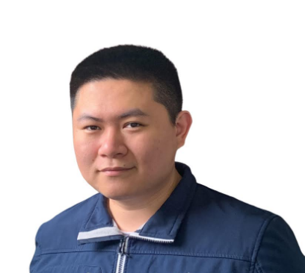
Today’s CHW Café Chat Contributors
Megan Ellingson, CHW, MHA
Co-Founder
CHW Solutions
meganellingson@chwsolutions.com
Alma Galvan
Senior Program Manager
Migrant Clinicians Network
agalvan@migrantclinician.org
Dr. Ron Jankowski, Medical Director
CHW Solutions
ronaldjankowski@chwsolutions.com
Rene Gust, RN
Public Health Nurse
Hennepin County Public Health
renee.gust@hennepin.us
Megan Nieto, CHW
Co-Founder
CHW Solutions
megannieto@chwsolutions.com
Jiang Zhu, Web Developer and Designer
CHW Solutions
jiangzhu@chwsolutions.com
Dra. Dulce Lopez
Consultant and Licensed Psychologist
Founder, Metamorfosis thru Love
dra.crzn@gmail.com

Slide 5
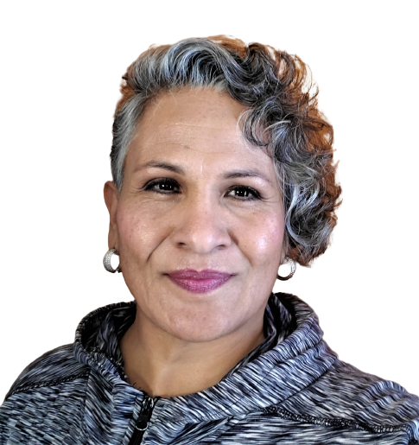
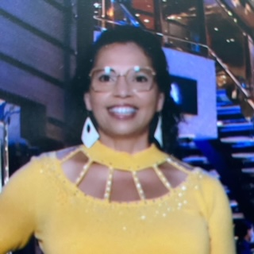
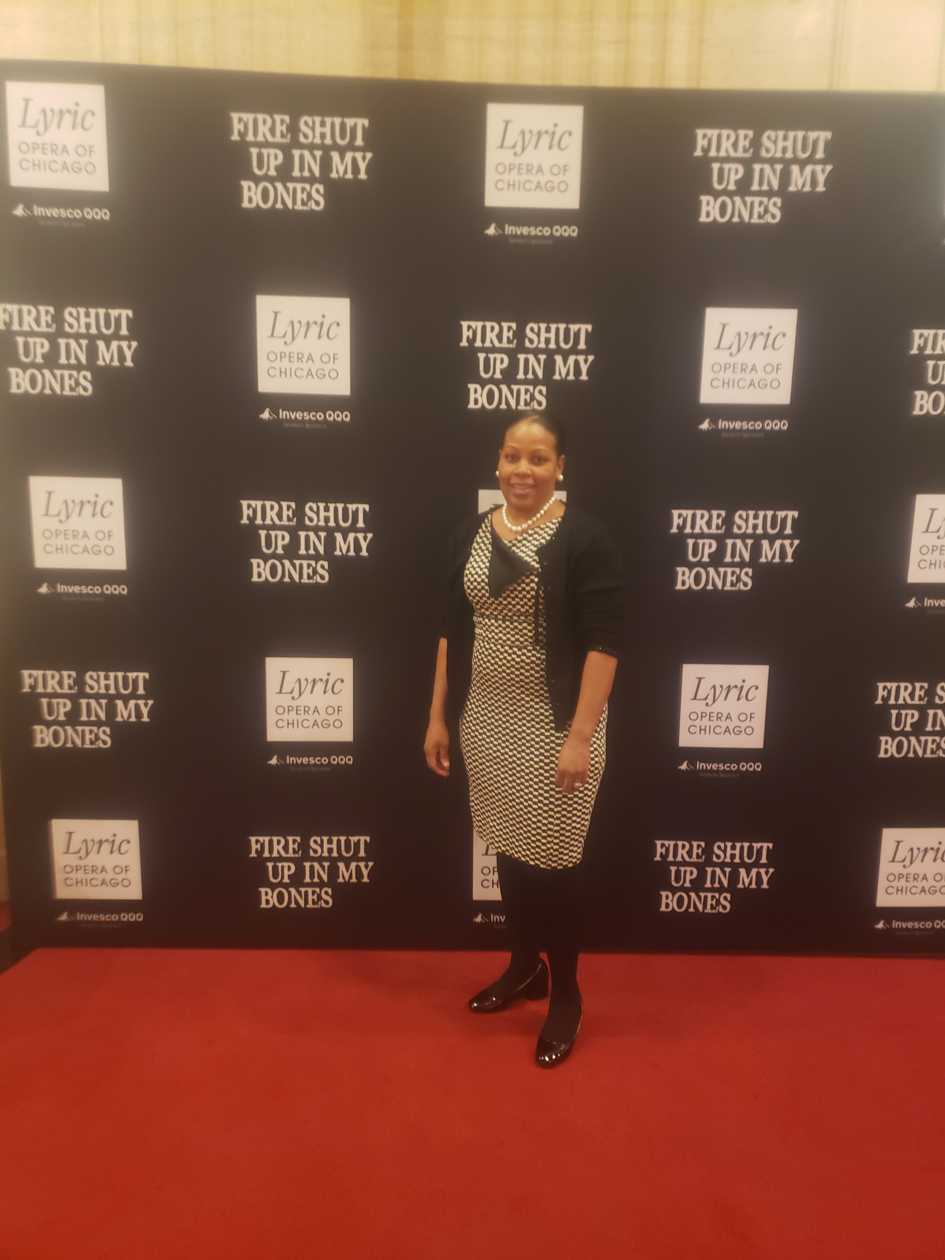
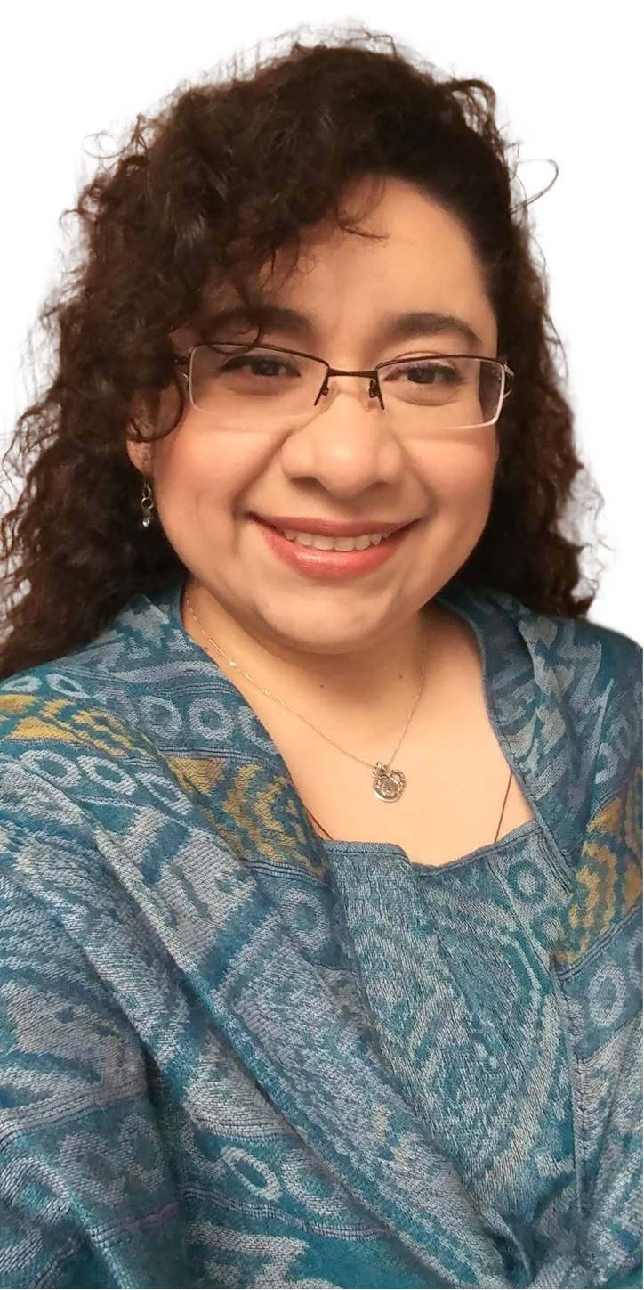
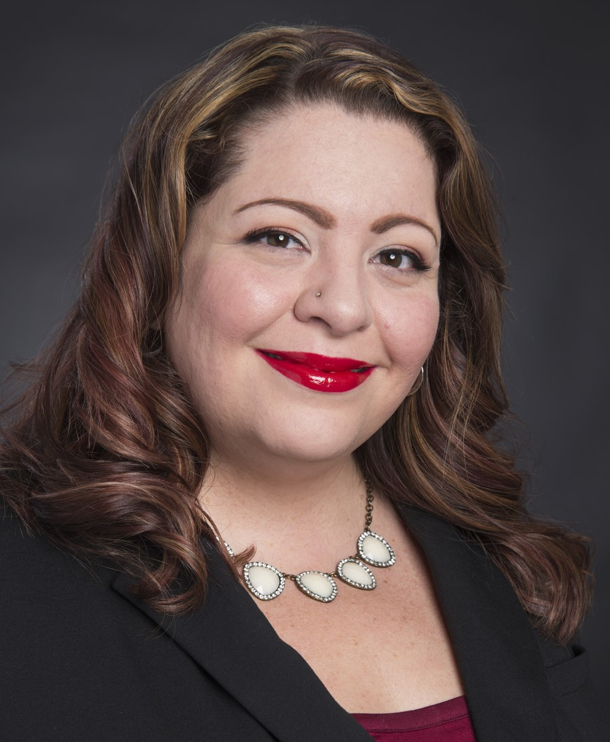
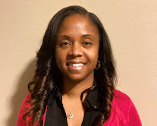
Today’s CHW Café Chat Contributors
Community Health Worker Panel
Fabiola Rodriquez, CHW
Coordinator
Border Biomedical Research Center
The University of Texas at El Paso
byfmo1@gmail.com
Paula Brown, CHW Senior
Hennepin Healthcare
Paula.Brown@hcmed.org
Carol Parnell, CHW
Amen Ministries
carol.parnell2015@gmail.com
Ebonee Stevenson, CHW
Program Manager
Illinois CHW Association
eboneenstevenson@gmail.com
Hilda Sanchez Herrera, CHW
CHW Solutions
hildaherrera@chwsolutions.com
Ashley Rodriguez, CHW
Texas
ashleymarti@gmail.com
Tarri Wyre, CHWI, BS
Manager, Community Health Workers
Community Benefits Corporation
Memorial Hermann Health System
Andre Pappas, CHW
Andre_Pappas@rush.edu

Slide 6
CHW Summer Café Chat Summary
June 21, 2022 What is it like being a CHW during the COVID pandemic?
July 19, 2022 What did we do to make it through? CHW Self-Care
August 23, 2022 What’s next for CHWs? Motivating Patients and Communities to Choose Health
ALL Chats:
Share NRC-RIM resources
Discussion with fellow CHWs
https://nrcrim.org/toolkits/community-health-workers

Slide 7
Dra. Dulce Lopez
Consultant and Licensed Psychologist
Founder, Metamorfosis thru Love
dra.crzn@gmail.com

Slide 8
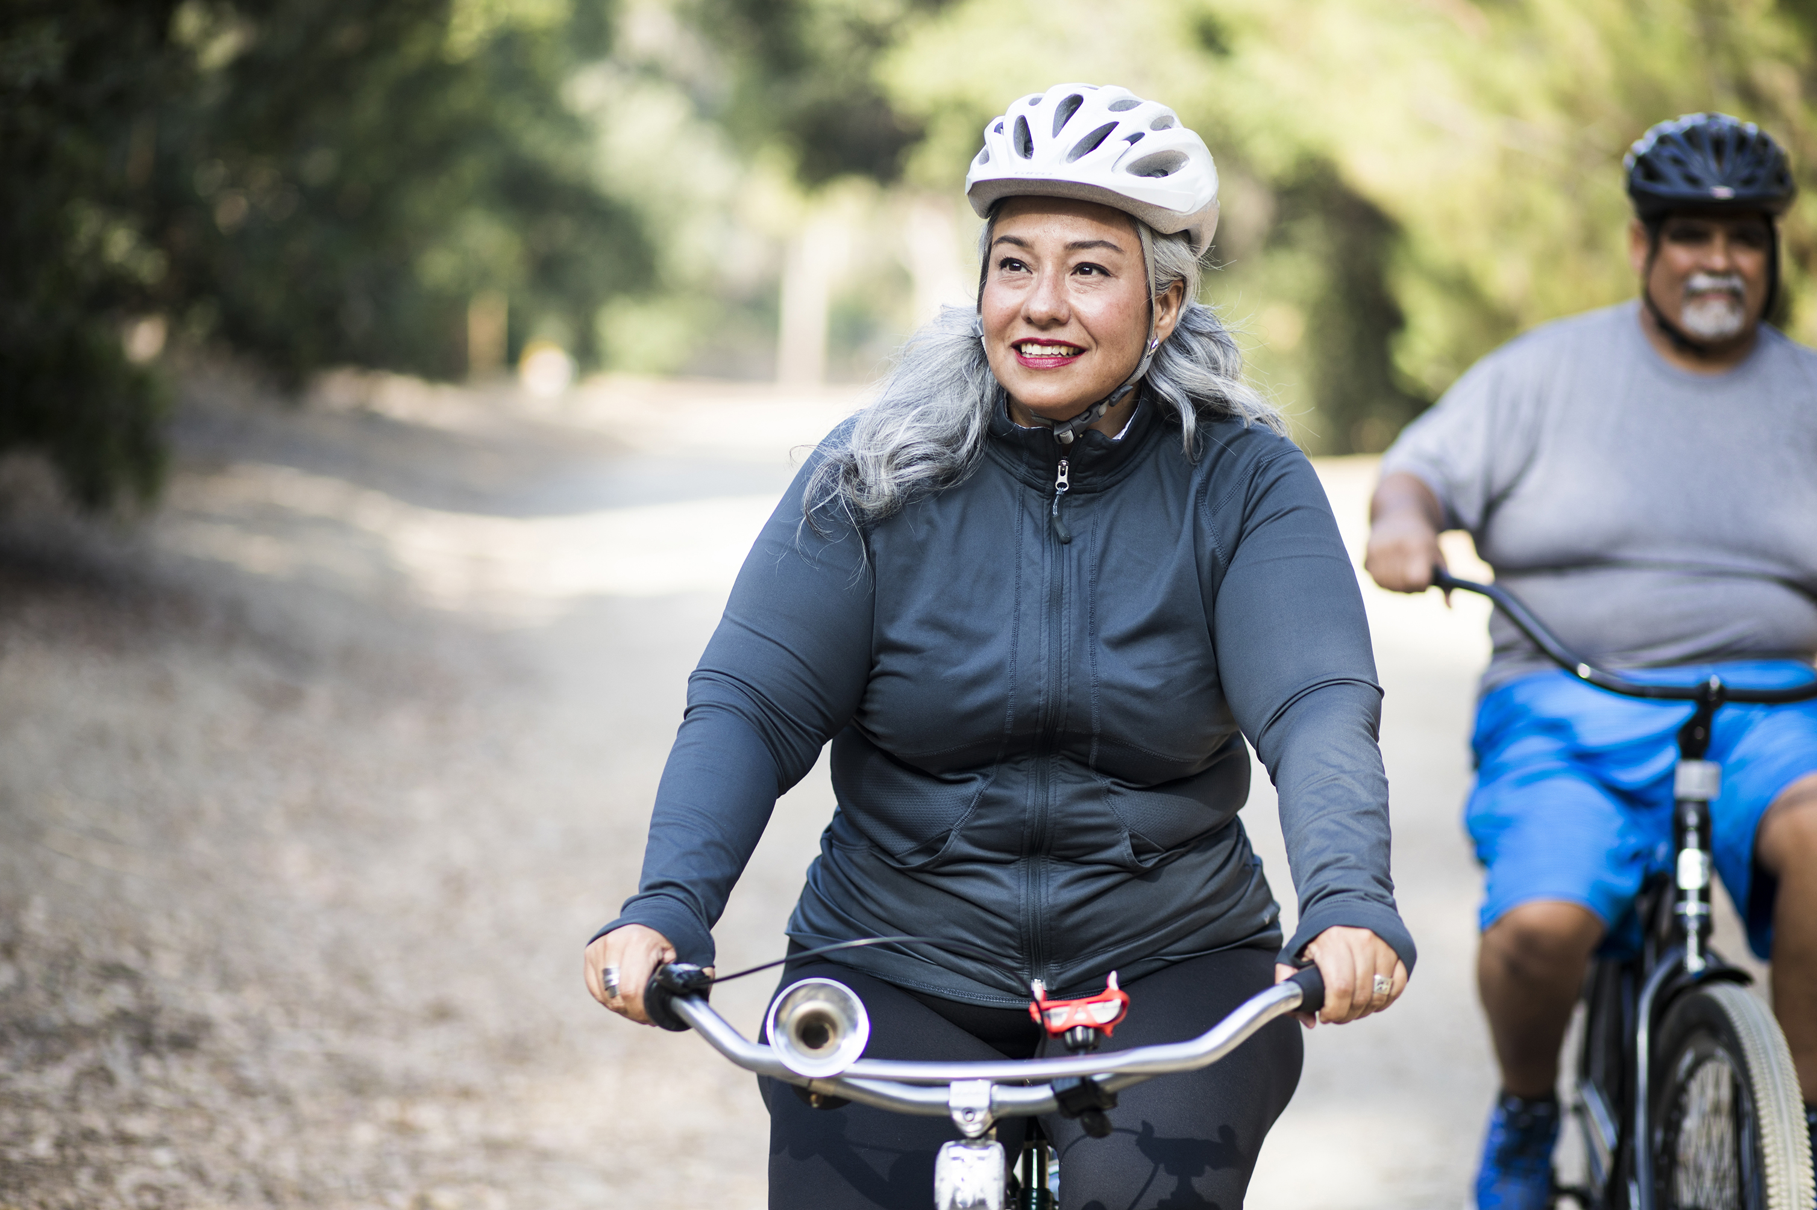
CHWs and Health Coaching
Renee Gust, PHN
Hennepin County Public Health
3 Recorded Trainings Available Online
Introduction to Health Coaching
Nutrition
Physical Activity
Sign-up for The Health Coach Newsletter (email Renee @ renee.gust@hennepin.us)
Patient Action Plan
https://chwsolutions.com/sharing-library/

Slide 9
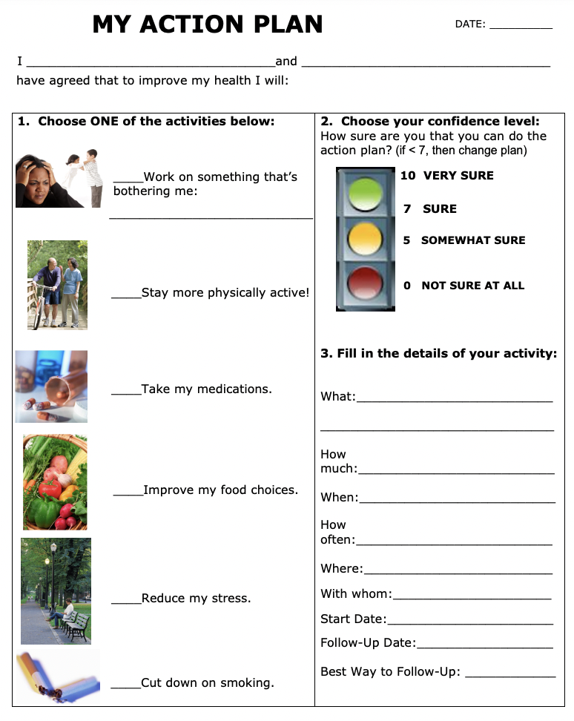
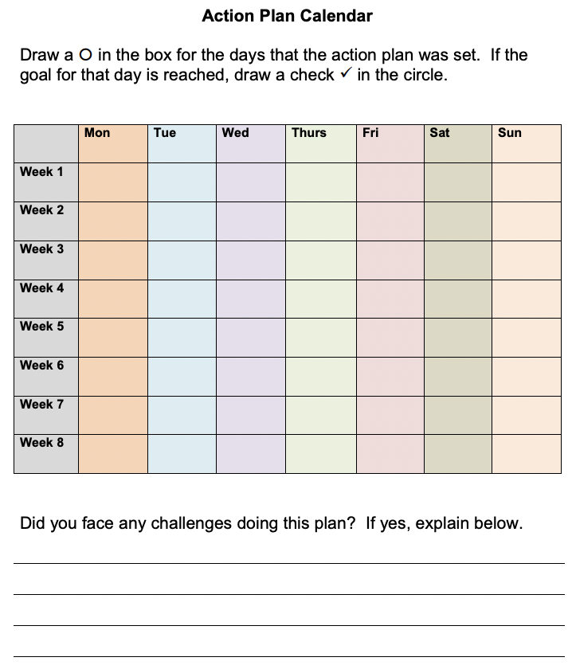

Slide 10
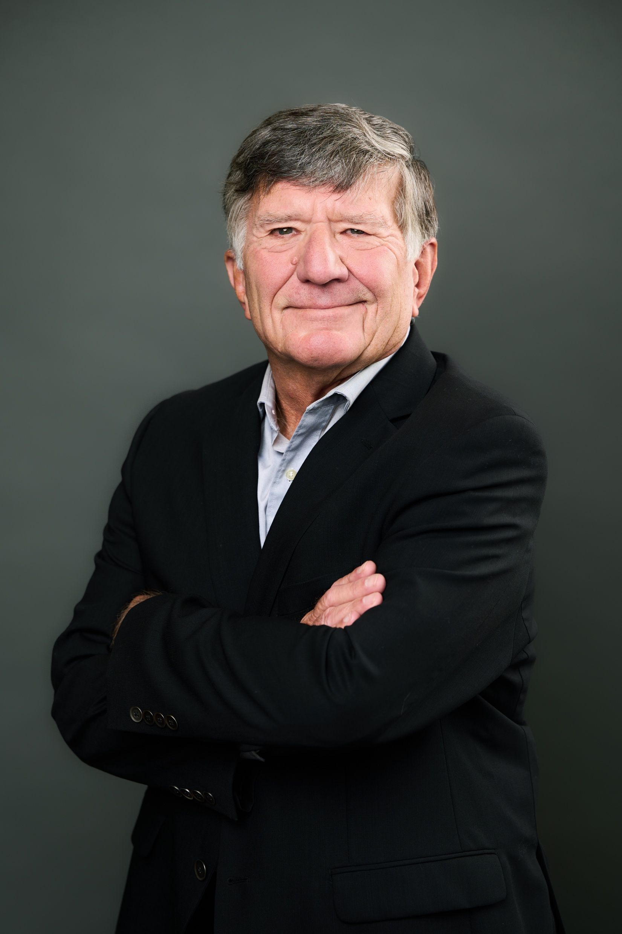
CHWs Working with Primary Care Providers
Ron Jankowski, MD
Medical Director, CHW Solutions
How have you seen CHWs help patients choose health?
In an ideal world, what are the ways CHWs can relate to physicians and other clinicians?
As a primary care physician, what do you most want CHWs to know about their role and impact?

Slide 11
Migrant Clinicians Network
Alma Galvan, Senior Program Manager
What’s next for Community Health Workers at MCN?

Slide 12
Today’s CHW Café Chat Contributors
Community Health Worker Panel
Fabiola Rodriquez, CHW
Coordinator
Border Biomedical Research Center
The University of Texas at El Paso
byfmo1@gmail.com
Paula Brown, CHW Senior
Hennepin Healthcare
Paula.Brown@hcmed.org
Carol Parnell, CHW
Amen Ministries
carol.parnell2015@gmail.com
Ebonee Stevenson, CHW
Program Manager
Illinois CHW Association
eboneenstevenson@gmail.com
Hilda Sanchez Herrera, CHW
CHW Solutions
hildaherrera@chwsolutions.com
Ashley Rodriguez, CHW
Texas
ashleymarti@gmail.com
Tarri Wyre, CHWI, BS
Manager, Community Health Workers
Community Benefits Corporation
Memorial Hermann Health System
Andre Pappas, CHW
Andre_Pappas@rush.edu

Slide 13
Please let us know your ideas and suggestions for future chats:
https://www.surveymonkey.com/r/HBHZZQS

Slide 14
THANK YOU!!!!
https://nrcrim.org/toolkits/community-health-workers

